Slide 1
6426 Data Structures & Algorithms
Learning session 2

Slide 2
In This session…
Revision of Course information from last week
Visual Studio installation and GitHub
Revision of basic programming skills
Overview of Data Structures and Algorithms
Hands-on coding exercise

Slide 3
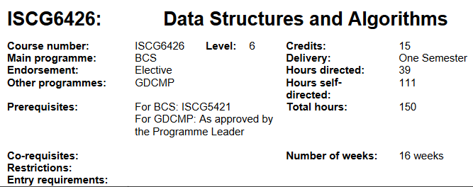
Our learning context

Slide 4
Course Prescription
Hours directed: | Hours Self-directed: | Total Learning Hours:
39 | 111 | 150

Slide 5
Each Week Time Allocation ( in Hours)
Hours directed: | Independent work | Project
3 | >1 | >0
 | = 8.5

Slide 6

Textbooks & Software
Software
Visual Studio 2017, 2019, 2022
Visual Studio Code
Git: Github, GitLab, BitBucket
Cloud: Onedrive (Unitec)
Physical copy: SSD, USB
Reference site
C# Documentation
Storage & Backup

Slide 7
Need a break?
Data Structures overview

Slide 8
What are Data structures
Structures to hold data in computer’s memory, for application to interact with them.
- Integer, Floating point, Character, Pointer
Primitive data
Data Structures
Array, Lists, Stack, Queue, Dictionary, Tree, Graph
Non-primitive data
For this course, our focus is on non-primitive data structures that hold collections of data, such as Arrays and Lists.

Slide 9
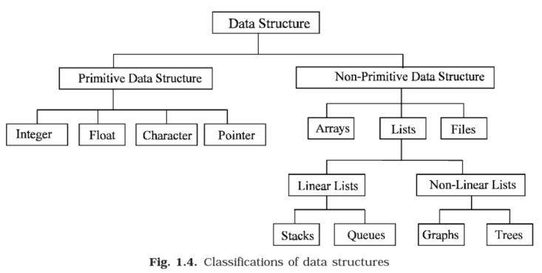
(Das, 2006)

Slide 10
Why do they matter?
Your choice so far in other classes may have been random, when choosing your collections
In a demo program, you can get away with your choice
In real-world, they have a massive influence on how efficient the performance of your software going to be
What is the best or most efficient data structure?
In this course, we learn which data structures perform better in which situations and under what conditions

Slide 11
Arrays
Array is our friend
All programming languages provide arrays to store a collection of data items in memory
Array is a collection of homogeneous data elements described by a single name (Das, 2006 p.10)
We declare an array in c#:
int[] MyArray = new int[100];

Slide 12
Arrays (cont.)
Each element of an array is referenced by a subscript (index)
MyArray[0] = 5;
The above is a single dimensional array.
You can create double or multi-dimensional arrays
  int[,] DblArray = new [3,4];
Arrays are easy to use, suitable for most situations. If you want to store a list of items and then iterate through each of them in a loop, performing some action on them.

Slide 13
Arrays (cont.)
Int[] A = new int[5];
A[0] | A[1] | A[2] | A[3] | A[4]
A[1] = 10; A[4]= 25; A[0] = 80;
Any element in the array can be accessed directly using its subscript, e.g., A[1], A[2]…. A[100] etc. If there were 100 elements, to access A[99], we do not have to traverse from A[0], A[1]…A[99].

Slide 14
Arrays (Cont.)
Disadvantages are:
  The size of an array is fixed when it is instantiated. It can not grow, or shrink
  We need to determine the array size at design-time and may waste memory allocation
  We can’t access a value by a key as in a key/value pair (Dictionary)
Can you think of how an Array can grow dynamically?
https://docs.microsoft.com/en-us/dotnet/api/system.array?view=net-6.0

Slide 15
(Das, 2006)

Slide 16
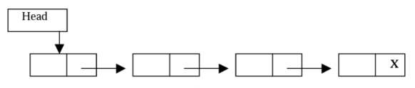
Lists
Lists are more versatile to use, because they can grow by adding and deleting data items to the list.
We do not need to know an initial size, unlike Array size declaration
Linked Lists are nodes that contain a data item and a reference to the location of next data item, as shown below (Das, 2006 p.13).

Slide 17
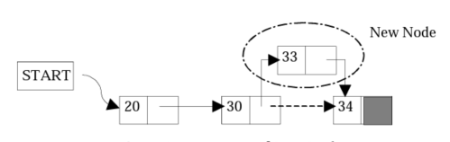
Linked lists (cont.)
Insertion or deletion of a node at any arbitrary point is easy (Das,2006).

Slide 18
Lists (cont.)
Lists can solve the Array’s problem of adding and removing items
There are other functionality and behaviour we can get from other data structures.
Queue and Stack are kind of lists that is useful for specific scenarios

Slide 19
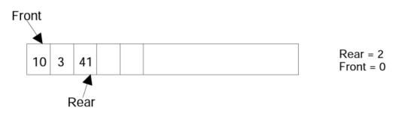
Queue
First in-First out (FIFO)
enqueue() to add an element and dequeue() to remove the element in the front.
C# implementation details at:
https://docs.microsoft.com/en-us/dotnet/api/system.collections.queue?view=net-6.0

Slide 20
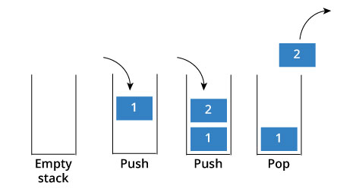
Stack
Last-in-First-out (LIFO)
push() to add elements
pop() to remover elements
Static Stacks implemented using Arrays
Dynamic Stacks use Linked Lists

Slide 21
Hash tables/Dictionary
They use key/value pairs, which makes it easy to access an element using its key
Dictionary<string, string> dicCity=new Dictionary<string, string>
{
{ “John", “Auckland" },
{ “Peter", “Christchurch" }
};
string City = dicCity[“Peter”];

Slide 22
Why do we need Data Structures ?
Apart from the different features we would like to have, two other main reasons to choose the right DS for right job are for:
  Searching
  Sorting
Interfaces
Data Structures
Implementations

Slide 23
Searching
. . . . . . .
1 | 3 | 10 | 12 | 14
255 | 280
1 2 3 4 5 . . . . . . . . . . . 99 100
If we want to find value 75 within this collection, we can start traversing from 1-100 until we find 75.
Is there a better way to do that ?

Slide 24
Algorithm
What is an Algorithm?
  “A step-by-step finite sequence of instructions, to solve a well-defined computational problem” (Das, 2006)
The efficacy is measured by space & time complexity
What problems have you faced that can be solved with an algorithm?

Slide 25
Searching
1 | 3 | 10 | 12 | 14
. . . . . . .
255 | 280
1 2 3 4 5 . . . . . . . . . . . 99 100
If we want to find value 75 within this collection, we can start traversing from 1-100 until we find 75.
Is there a better way to do that ?

Slide 26
Algorithm uses
An array of numbers that need to be ordered from smallest to largest
  A sorting algorithm
Find a particular student from a class enrolment list
  A search algorithm
Obscure information so others cannot read it easily
  Encoding algorithm, Hashing algorithm

Slide 27
References
Das, V. V. (2006). Principles of data structures using C and C++. New Age International.

Slide 28
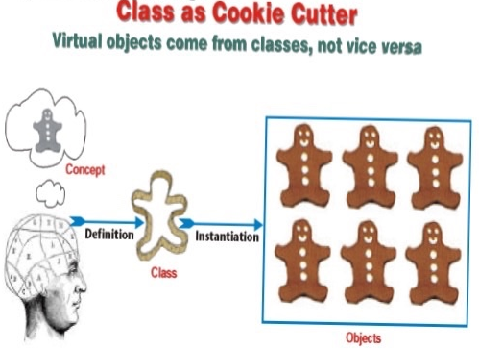

C# class - Revision
Class is a template, like a cookie-cutter
When you create a new instance of a class (instantiate a class), you get a new Object of that class
When you instantiate a Student class, you get a new Student object
Classes have Properties, Methods, Fields, and events

Slide 29
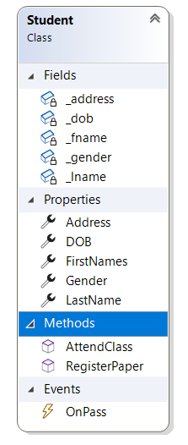
Class structure
public class Student
{
private string _fname;
private DateTime _dob;
public void RegisterPaper( string PaperID)
{
}
public bool AttendClass()
{
}
}
Classes have:
Fields
Properties
Methods
Events

Slide 30
Class constructor & overloading
public class Student
{
public Student()
{
}
public Student(string StudentID)
{
}
public void RegisterPaper(string PaperID)
{
}
public void RegisterPaper(int PaperCode)
{
}
public bool AttendClass()
{
}
}
Instantiating a Student object and calling its methods
public class Program
{
public void Initialize()
{
Student ThisStudent = new Student();
Student AnotherStudent = new Student(“1234”):
ThisStudent.RegisterPaper(“ISCG6426”);
AnotherStudent.RegisterPaper(6426);
bool AttendStatus = ThisStudent.AttendClass();
}
}

Slide 31
Instantiating variables
Declaration
int Price;
double Height;
string Name;
char Gender;
bool Married;
Student ThisStudent;
Button Okbutton;
TextBox NameTextBox;
int[ ] MyGrades;
string[ ] CountryList;
Value Assignment
Price = 100;
Height = 175.4;
Name = “John Doe”;
Gender = ‘M’;
Married = false;
ThisStudent = new Student();
Okbutton = new Button();
NameTextBox = new TextBox();
MyGrades = new int[23];
CountryList = new string[10];
Instantiation
int Price = 100;
double Height = 175.4;
string Name = “John Doe”;
char Gender = ‘M’;
bool Married = false;
Student ThisStudent = new Student();
Button Okbutton = new Button();
TextBox NameTextBox = new TextBox();
Int [ ] MyGrades = new int[23];
string[ ] CountryList = new string[10];

Slide 32
Getting started with C#
Open Visual Studio 2019/2017
  If not-yet installed, follow the instructions on Moodle to download and setup
Before we do any coding, a quick break
  15 minutes

Slide 33
Hands on exercise Revision from last week:
Create a Solution
Create a Project within the Solution. One VS Solution can have multiple Projects. E.g.:
  Console projects
  GUI (Windows Forms) project
  Web Application projects (Web forms, MVC, Web API, etc,)
  Xamarin projects for Phone Apps (Windows, Apple or Android)
  Class Libraries
  Test projects
Save the project in your Unitec-OneDrive
Upload to GitHub as your personal project
Create a second Visual Studio Solution by
cloning the class project

